Slide 2
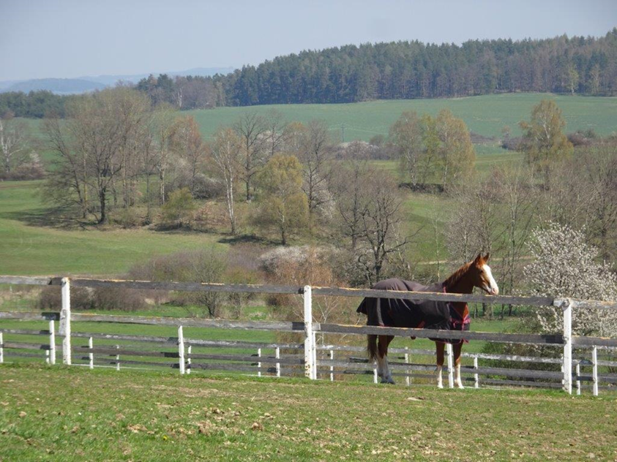
6. Sales from the Yard (Farm)
6.1. Imporance of sales from the yard, regional products
Recent years have shown that the seemingly unshakable position of globalization in world trade is being undermined. The problems that lead to the rise in prices of virtually everything are related to intercontinental transport, the war in Ukraine, rising energy prices, disproportionate plundering of natural resources, and were also catalyzed by a viral pandemic. What seemed stable and unchanging until recently is now variable and often uncertain. Not only European but also other countries are beginning to support domestic producers, who have often been on the margins of interest because, paradoxically, it was cheaper to import the commodity from the other side of the world.
Less support for global
X
More focus on regional
Notes:
The module deals with the explanation of what is understood as sales from the yard, especially in animal production, how sales from the yard are important for consumers and sellers. The importance of regional products and their support in the Czech Republic and selected EU countries.

Slide 3
Marketing and promotional campaigns, largely supported by public authorities, are beginning to reorient consumers towards regional products. This is reflected in particular in the promotion of the brands which the producer can obtain for his goods under certain, predetermined conditions. The trend is reflected not only in individual countries, but also at the level of the European Union. The purpose of these measures is
support
short food supply chains
and circular economics
EU-funded projects to promote regional products in the regions

Slide 4
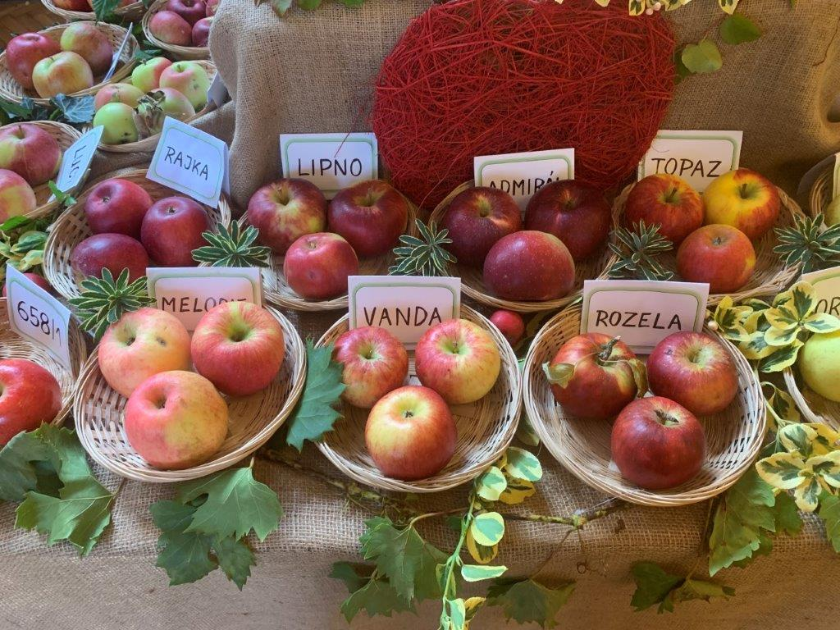
Short food supply chains (SFSC) can be defined as alternative sales methods that reduce the distance from the field to the table and bring producers closer to consumers. At the same time, the importance of the local community is growing.
These forms include:
farmers' markets and marketplaces,
box sales,
direct sale from the yard / farm, etc.
These forms of supplier-customer relationships have positive environmental, economic, social, health and well-being impacts and contribute to the sustainability of these systems.
Each country has specific varieties of fruit (Gardening Exhibition - Czech Republic)
Notes:
The leaflet of the Ministry of Agriculture of the Czech Republic (2017) states that short supply chains are a form of supplier-customer relations that emphasize the importance of regional foods, their use in catering facilities, gastronomy in general, local business and tourism. Their meaning is based on bonds between producers, consumers, chefs, schools, local authorities and associations, which together create a strong local community.

Slide 5
Sales from the yard can be explained as:
direct delivery of small quantities of products at the place of production
sales in markets and marketplaces
delivery to a local retail store that supplies products to the final consumer (a local retail store is considered to be a store with an appropriate range of animal products, which is from municipalities with a similar retail store, closest to the breeder's farm).
Sale from the yard - herbal soaps (Zahrada U malíře - Czech Republic)

Slide 6
Specific conditions for sale from the yard
The sale of food from the court is governed by national law and, beyond the common core of food hygiene, can be affected by a number of standards from a wide variety of sectors. As resources for individual national regulations highlight rules of a different nature in this context, some of these country-specific rules are highlighted.
Sale from the yard - apricot processing

Slide 7
Member county | Definition of "local" retail outlets, for the purposes of the exemption for sale from the yard | Some atypical rules regarding sales from the yard
Czech Republic | whole Czech Republic
Slovakia | whole Slovakia
Germany | 100 km radius for hunted animals, otherwise without restriction | Exceptions to the ban on opening shops on Sundays and public holidays depend on national regulations
Austria | no restriction | In-house sales of products are limited to the listed commodities
Poland | Voivodships of origin and neighboring voivodships | Special income tax scheme for direct sales of food products
France | 80 km radius
Hungary | Region of origin or 40 km radius | The institute of so-called "village tables for guests" allowing to sell in the exemption regime, a certain proportion of non-own products
Italy (Friuli-Venezia Giulia) | Provinces of origin and neighboring provinces | The commencement of activities is subject to the prior approval of the establishment with regard to hygiene standards
Comparative Study of the Parliamentary Institute No. 5.395 lists some atypical rules in selected states of the European Union regarding the sale from the yard

Slide 8
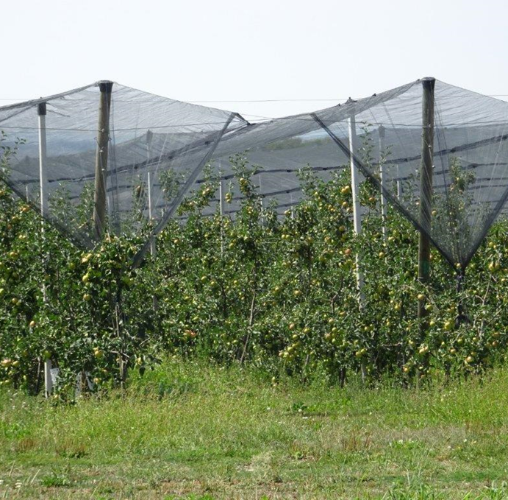
In most countries, sales from the yard utilize
exemptions from the EU Food Hygiene Regulation
The manufacturer is responsible for the safety and quality of the food placed on the market and its proper labeling.
Even smaller orchards are making progress in growing technologies (Česká republika)
Vending machine on the farm - sale of dairy products 24 hours a day, 7 days a week (Dairy farm Boubín, Česká republika)
Notes:
Czech Republic - Sales from the yard means the direct sale of a small amount of unprocessed primary products to the final consumer or to a local retailer (e.g. fresh unpacked poultry meat). These sales are covered by the derogation provided for in European Union regulations [see Article 1 (2) (a)]. (c) of Regulation (EC) No 852/2004, Article 1 (3) (a) c) of Regulation EC No. 853/2004], • this area is regulated by national legislation (provisions of Section 27a of Act No. 166/1999 Coll., on veterinary care).
Slovakia - Act No. 152/1995 Coll., On Foodstuffs (Food Act - hereinafter referred to as the “Food Act”), which lays down certain general rules concerning the hygiene and labeling of foodstuffs sold from of the Court, and Act No. 39/2007 Coll., on Veterinary Care (Act on Veterinary Care - hereinafter referred to as the “Veterinary Care Act”), which lays down special rules for food of animal origin. According to § 3 par. e) of Act No. 455/1991 Coll., the Trade Licensing Act (Trade Licensing Act).

Slide 9
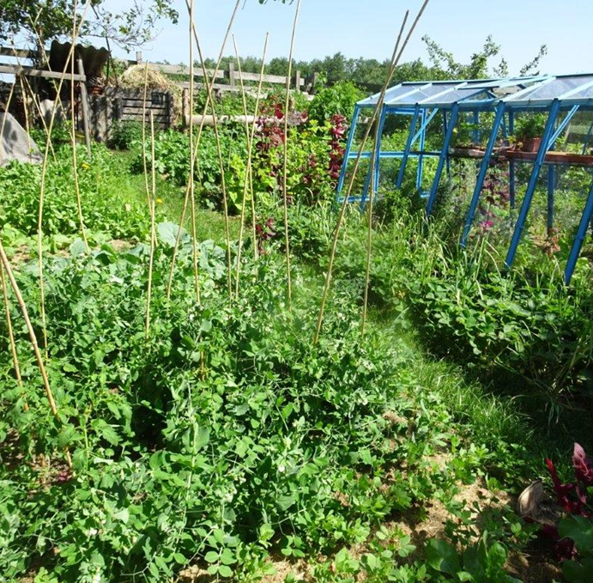
Sales from the yard - small garden can provide a varied year-round offer of vegetables and herbs (Zahrada U malíře – ČR)
Snacks on the farm from seasonal ingredients (SRN)
Notes:
Hungary - A producer who benefits from the exemptions from the EU Food Hygiene Regulation is responsible for the safety and quality of the food placed on the market (§ 3 (1) of Regulation 52/2010). The sale of food in accordance with Regulation No. 52/2010 may also take place at the residence of the producer, or the residence of his spouse, same-sex partner, adult child, sibling, parent or grandparent (§ 3 paragraph 2 of Regulation No. 52/2010) . The processing / production of food sold from the yard may also take place outside facilities where animals are bred or plants are grown, if the conditions do not allow such a procedure (Section 3 (3) of Regulation No. 52/2010).
Poland - Polish Law on Food Safety and Nutrition (ustawa o bezpieczeństwie żywności i żywienia - hereinafter 'b.z.z.') defines direct sales (dostawy bezpośrednie) in Article 3 (1) (10) by reference to the exemption for sale from the court under Article 1. paragraph 2 (a) (c) the Food Hygiene Regulation. Direct sales in this sense are not subject to the generally required permit in b.z.z. (Article 63 (2) (1) of the Code). However, farmers are also obliged to comply with the principles of good hygiene practices for direct sales (Article 68 (1) of the Code).

Slide 10
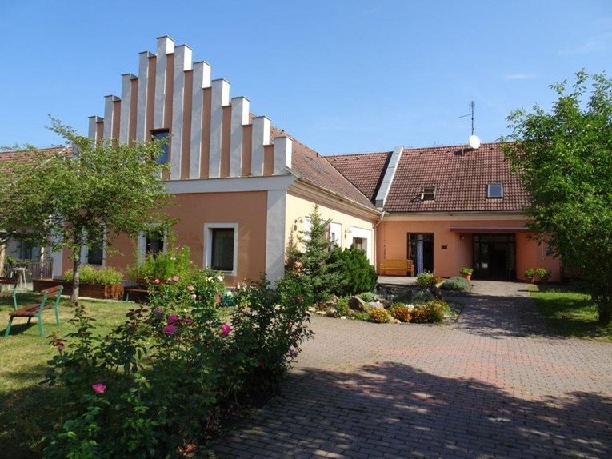
.
Social enterprises often use yard sales in their own shops and raise local community awareness of the scope of their, often occupational therapy activities (Domov sv. Anežky, Týn nad Vltavou, ČR)

