Slide 2
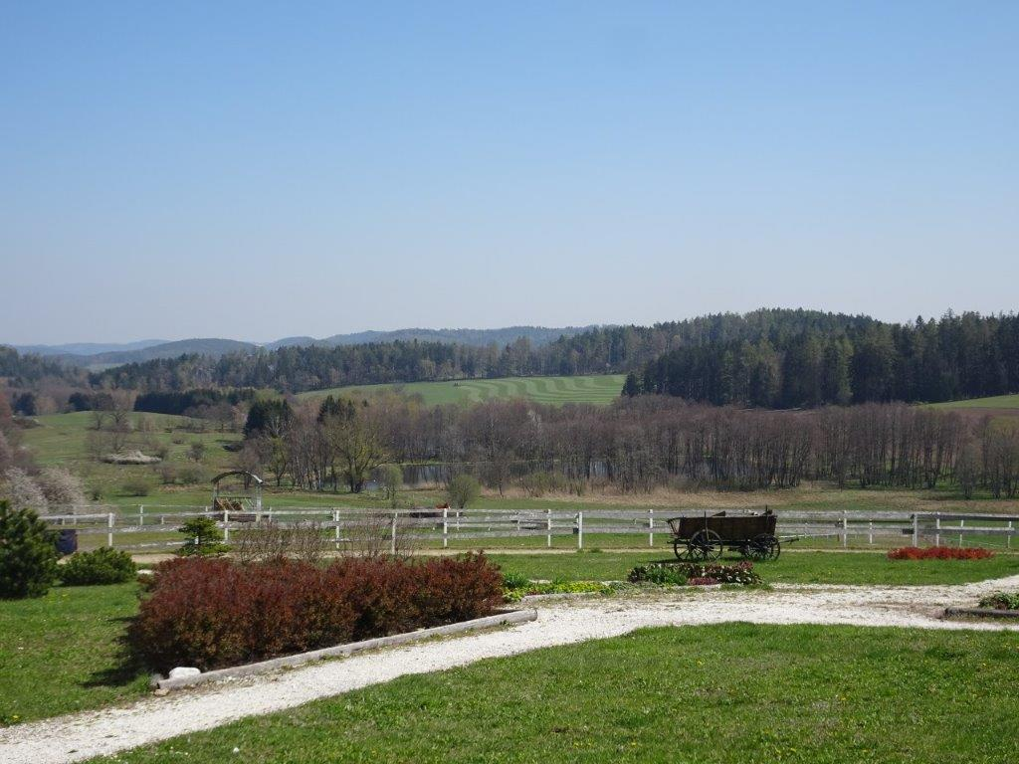
6. Sales from the Yard (Farm)
6.2. Sales from the Yard - rules, regulations, administrative oversight
Notes:
The module describes the conditions under which sales from the yard can be made in the Czech Republic and selected countries of the European Union. An overview of legislative standards valid in the Czech Republic and their connection to EU law. Hygiene and veterinary regulations. State authorities supervising the sale from the yard.

Slide 3
6.2.1. General legislation
All EU legislation on agricultural commodities and food can be found on the portal https://eur-lex.europa.eu/, in which it is possible to search in individual languages of the member states of the Union. Everything is subject to the law of each Member State.
European legislation on the sale of food:
EU Regulation No. 1169/2011 on the provision of food information to consumers
EU Regulation No. 1308/2013 on the common organization of the market in agricultural products
EU Regulation No. 852/2004 on food hygiene
EU Regulation No. 853/2004 on the hygiene of animal food
EU Regulation No. 854/2004 on official controls
EU Regulation 178/2002 on food safety
Many farms can offer social spaces

Slide 4
Exception for the sale of food from the yard
According to Article 1 (2) (a) c) regulations on food hygiene, resp. Article 1 (3) (a) (c) of the Regulation on the hygiene of food of animal origin provides that the Regulation does not apply to cases where a producer directly supplies small quantities of primary products to the final consumer or to a local retailer who supplies them directly to the final consumer.
Member States shall lay down the rules for this activity to ensure that the objectives of both regulations are achieved. Exceptions to the scope of directly applicable EU rules must pursue the same objectives as those rules.
The original farm buildings acquire new functions

Slide 5
6.2.2. Czech Republic
A person selling food from the yard will most likely not need a trade certificate. This does not preclude other types of registration.
Agricultural entrepreneurs are generally registered under the Agricultural Act
Heat preservation is a popular form of preserving seasonal fruit
Notes:
From the point of view of the general legal framework for business, a person selling food from the court will usually not need a trade certificate (cf. § 3 paragraph 3 letter e) of Act No. 455/1991 Coll., Trade Licensing Act), but this does not exclude other types of registration. Agricultural entrepreneurs are generally registered on the basis of § 2f of Act No. 252/1997 Coll., The Agricultural Act, registration under § 2e paragraph 2 of this Act is not subject to, inter alia, a natural person who sells unprocessed plant and animal products (it is therefore primary production, which are also narrower in some cases relevant to sales from the yard).

Slide 6
Specific regulations in the Czech Republic:
The issue of the sale of animal products from the yard is dealt with in the Czech Republic by the Veterinary Act.
In the case of other foods, the procedure is in accordance with the Act on Food and Tobacco Products and on the amendment of some related acts. This provision empowers the Ministry of Agriculture to regulate the requirements for foodstuffs of plant origin, their handling and their sale "from the court" through a decree.
Many farms allow visitors to get acquainted with different breeds of livestock
Notes:
Specific regulations in the Czech Republic: the issue of sale from the court is dealt with especially in the case of the sale of animal products, namely by Act No. 166/1999 Coll., On Veterinary Care and on Amendments to Certain Regulations (hereinafter the "Veterinary Act"). The space for treatment of a similar type in the case of other foods is also provided by § 18 par. d) of Act No. 110/1997 Coll., on Food and Tobacco Products and on Amendments to Certain Related Acts. This provision empowers the Ministry of Agriculture to regulate the requirements for foodstuffs of plant origin, their handling and their sale "from the yard" through a decree.

Slide 7
6.2.3. Slovakia
Similar legislation applies as in the Czech Republic.
State administration bodies in the matter of official food control pursuant to Act 152/1995 Coll. (Food Act) are:
Ministry of Health
public health authorities
state veterinary and food administration
regional veterinary and food administrations
https://www.predajzdvora.sk/
Sale from the yard - Predaj z dvora

Slide 8
6.2.4. Hungary
In Hungary, the issue of food sales from the court is regulated in particular by Regulation No. 52/2010 of the Ministry of Agriculture, on the conditions for the production and sale of food by small producers.
This regulation also determines the quantities for sale from the yard, lays down the conditions for the sale of food to local retailers and the rules for "village guest tables".
Impressive Hungarian steppe cattle - an attractive local breed
Notes:
In Hungary, the issue of food sales from the yard is regulated mainly by Regulation No. 52/2010 of the Ministry of Agriculture, on the conditions for the production and sale of food by small producers (hereinafter referred to as Regulation No. 52 / EC). 2010). Quantities considered small for sale from the yard are defined in Annex I to Regulation No 52/2010. The sale of food to a local retailer is then considered to be the sale of food to a retail store located in the same region or at a maximum distance of 40 km from the farmer (§ 1 of Regulation No. 52/2010). However, producers are also allowed to operate "village tables for guests".

Slide 9
Producers are allowed to operate "village guest tables" (falusi vendégasztal) as a retail activity within the meaning of EU law, where they can also offer other food they have not produced if they comply with the prescribed quantitative limits (§ 4 (3) of Regulation 52/2010), respectively to deliver goods in the same region or 40km radius to the buyer who requested them (§ 4 paragraph 4 of Regulation No. 52/2010).
Mindigfinom (Bökfürdő - Bő) - Village Guest Table
Offer of "village guest table"

Slide 10
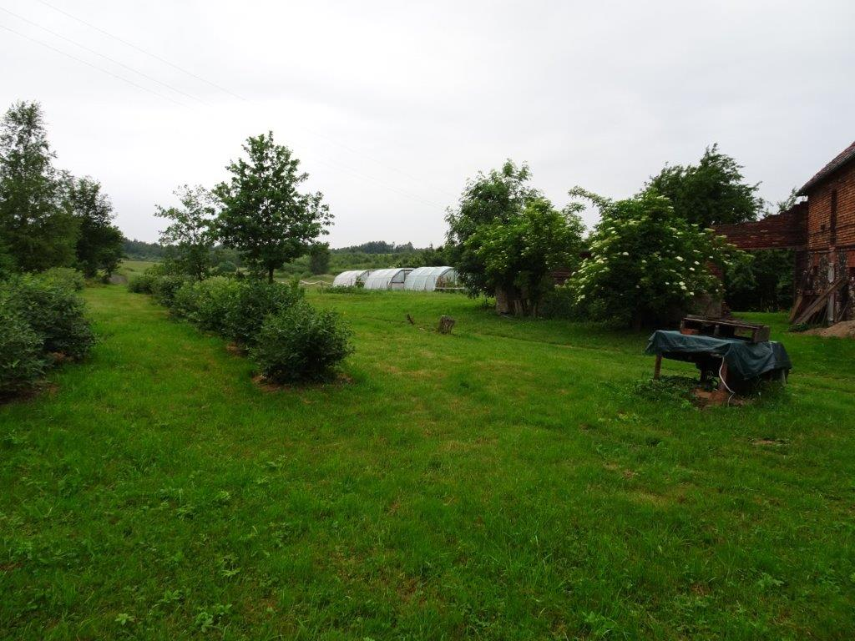
6.2.5. Poland
The current regulation of agricultural sales from the yard was introduced at once through a comprehensive amendment, so the regulation of sales from the yard in Poland is relatively consistent, including the taxation of products sold.
Kamchatka honeysuckle for yard jam production - Grabyszice Gorne (PL)
Notes:
Poland - Act of 16 November 2016 (Dz.U. 2016 pos. 1961) with effect from 1 January 2017.
Farmers selling their products directly from the court are primarily subject to a special tax regime under the Polish Personal Income Tax Act (ustawa o podatku dochodowym od osób fizycznych - hereinafter "p.d.o.f.").
Income from this activity up to PLN 40,000 per year is exempt from personal income tax (Article 21 (1) (71a) (p.d.o.f.). Pursuant to Article 6 (1) (1) of the Polish Trade Licensing Act (Prawo przedsiębiorców - 'p.b.'), P.b. does not apply, inter alia, to agricultural production in the field of animal husbandry and cereals or inland fishing.

Slide 11
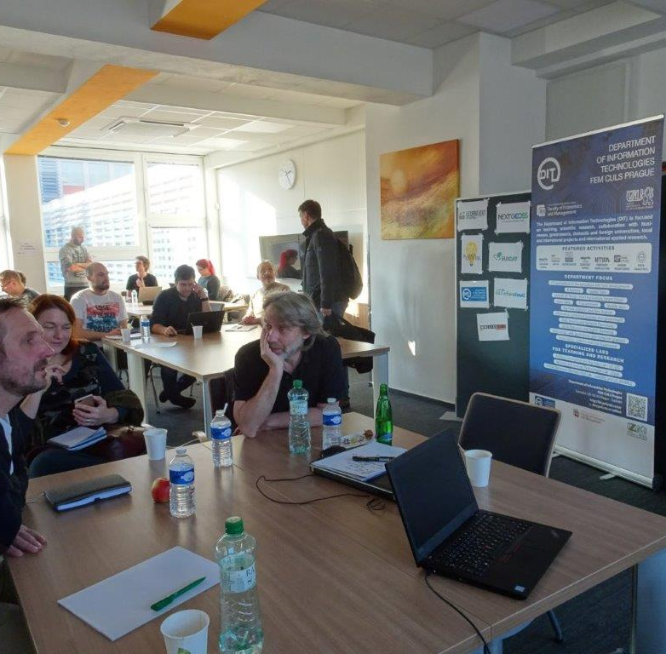
Products from local farms - Italy (Bologna)
Consortia of international projects also work on solving tasks for small farmers

