Slide 2
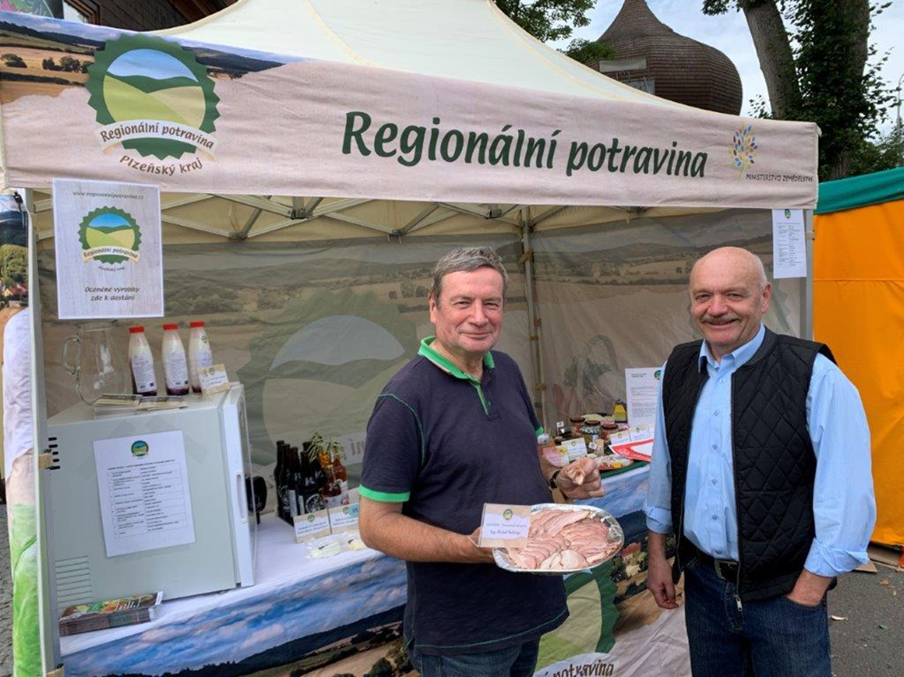
6. Sales from the Yard (Farm)
6.3. Animal products
Notes:
The module focuses on the main animal commodities that are sold from the yard. Quantity, place and other conditions of sale.
It is about:
Fresh poultry meat
Fresh rabbit meat
Unwrapped fresh eggs
Bee products
Raw untreated milk and raw cream
Live fish and other aquaculture products
Game

Slide 3
6.3.1. General legislation
In general, supervisory authorities are subject to stricter conditions for sale from the yard than for crop products. This is logically due to the nature of animal products, their limited shelf life and the greater risk of transmission of parasites and diseases to humans.
In the Czech Republic, in accordance with Nationwide rural networks, Váňa et al. (2018) outlines general schemes of obligations for processors of meat, milk, eggs. These are, with minor modifications, also applicable to other EU countries.
Satisfied calf is a basic prerequisite for successful breeding and future quality meat and dairy production (Boubín Farm, Czech Republic)

Slide 4
6.3.1.1. Sales and processing of meat Source: Váňa et al. (2018)

Slide 5
Many farms allow visitors to get acquainted with different breeds of livestock

Slide 6
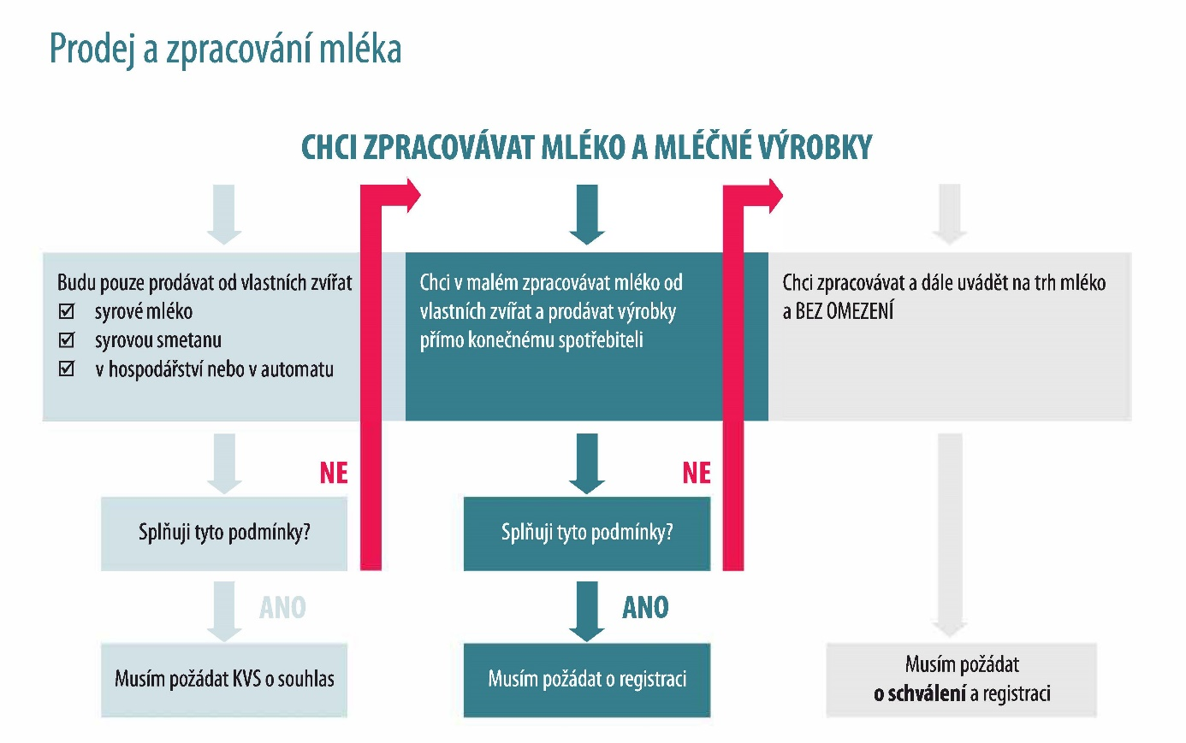
6.3.1.2. Sales and processing of milk
Prodej a zpracování mléka Zdroj: Váňa a kol. (2018)

Slide 7
Handicraft butter production in traditional wooden molds

Slide 8
6.3.1.3. Sales and processing of eggs Source: Váňa et al. (2018)

