Slide 2
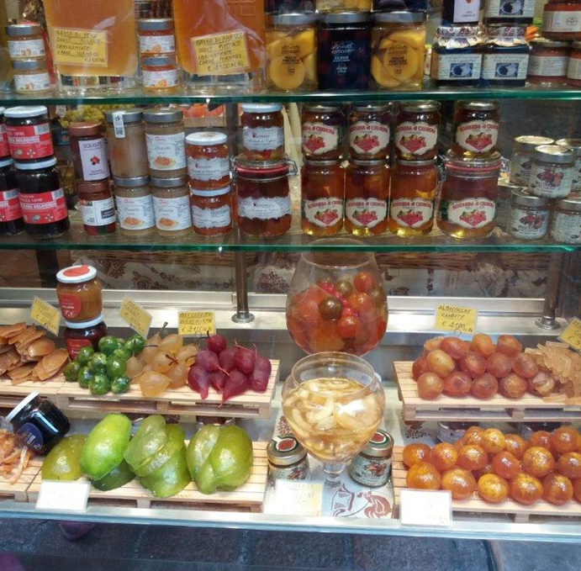
6. Sales from the Yard (Farm)
6.4. Animal products - conditions of sale from the yard in selected EU countries
Notes:
The module focuses on the main animal commodities that are sold from the yard. Quantity, place and other conditions of sale.
It is about:
Fresh poultry meat
Fresh rabbit meat
Unwrapped fresh eggs
Bee products
Raw untreated milk and raw cream
Live fish and other aquaculture products
Game

Slide 3
6.4.1. General legislation
Comparative Study No. 5.395 of the Parliamentary Institute (2020) states that the sale of foodstuffs of animal origin in the Czech Republic is mainly dealt with in Section 27a of the Veterinary Act, which allows smaller live animals to be sold in small quantities, fresh meat from these smaller animals. fresh eggs from our own farm, honey and other bee products and, with the consent of the regional veterinary administration, subject to special hygienic conditions, raw milk and raw cream. This provision allows food to be sold in a more lenient manner, for example without the need for approval or registration in accordance with veterinary law. Depending on the type of agricultural product, it may be a direct sale to consumers on their own farm, in a market or market, or to a local retailer (Section 27a (1) of the Veterinary Act). For the purposes of this rule, retail means retail within the meaning of Article 3 (7) of the General Regulation if it is located in the Czech Republic and supplies products directly to the consumer (Section 27a (2) of the Veterinary Act).
Even small farms use modern technology

Slide 4
6.4.2. Terms of sale in selected EU countries
6.4.2.1. Czech Republic
Act 166/1999 Coll., On veterinary care (provisions of § 27a) and Decree No. 289/2007 Coll., On veterinary and hygienic requirements for animal products that are not regulated by directly applicable regulations of the European Communities.
This decree lays down the conditions for the distribution of small quantities of products originating from the farmer's holding.
The following conditions are set for individual product categories:
Halls for fattening chicken broilers, Czech Republic

Slide 5
Fresh poultry meat
Maximum annual production of live animals 2000 turkeys, geese or ducks, or 10000 other poultry.
Unsorted meat of up to 10 turkeys, 35 geese, 35 ducks and 35 other poultry sold or delivered within one week is considered a small quantity that can be sold to the final consumer on a holding, the nearest market or market or a local retailer. The meat must not be further distributed and is intended for consumption in the consumer's household after heat treatment.
Fresh rabbit meat
A farmer who keeps rabbits in small quantities may sell or supply unsliced fresh rabbit meat in small quantities under similar conditions as fresh poultry meat, ie a maximum of 35 pieces per week.

Slide 6
Game
The hunter may sell or deliver the wild game caught in skin or feathers, in small quantities directly to the final consumer, or to a retail store, or to a retail place designated for game handling, or to the nearest market or small game market. which sells it directly to the final consumer.
A small amount of game intended for sale (delivery) is considered to be 5 large wild game and 35 small wild game per week, but no more than 50% of game hunted in one game per year, and this 50% may not exceed 120 pieces of large wild game and 400 pieces of small wild game. The game may not be further distributed and is intended for consumption in the consumer's household after heat treatment.
In general, any slaughter of cervids shall be subject to the same conditions as the slaughter of bovine animals under 72 months of age.

Slide 7
Fish
The farmer may sell live fish or other aquaculture animals directly in small quantities directly to consumers on his holding or place fresh fishery products on the market while providing on-site catering services.
A small quantity of live fish or other aquaculture animals shall be deemed to be a quantity of live fish or other aquaculture animals corresponding to the normal daily consumption of those live fish or other aquaculture animals in the consumer's household.

Slide 8
Raw milk
Raw milk and raw cream may not be put into circulation for direct human consumption, except for their sale at the place of production directly to the final consumer or through a vending machine directly to the consumer for consumption in his household, in small quantities (direct sale of raw milk).
A small quantity of raw milk and cream intended for direct sale to one final consumer shall be deemed to be a quantity of such milk which corresponds to the normal daily needs of that milk in that consumer's household.

Slide 9
Fresh eggs
Fresh eggs which are the subject of a direct sale by the breeder to the final consumer, in small quantities on his own holding, market or market, or delivered to a local retailer, may not be further marketed.
A small quantity of fresh eggs sold directly to the final consumer (on the farm or at the market), is considered to be 60 eggs per final consumer. A maximum of 600 eggs is considered a small quantity of fresh eggs which may be delivered once per week to a local store.

Slide 10
Bee products
A quantity not exceeding 2 tonnes per year is considered to be a small quantity of honey intended for sale by the farmer in the farmer's household, the farmer's holding, in the market or in the market place directly to the consumer for consumption in his household, or for delivery by the farmer to the retail store. Honey is intended for consumption in the final consumer's household.

Slide 11
6.4.2.2. Slovakia
The sale of food of animal origin is regulated in more detail by the Veterinary Care Act. Primary producers who sell primary products of animal origin directly to final consumers or local retailers are obliged to apply to the territorially competent regional and food administration for registration of each establishment they control (Section 40 (1) and (3) of the Veterinary Care Act). Special hygienic rules for the sale of food from the court are again laid down in Regulation No. 360/2011 Coll., And Government Regulation of the Slovak Republic No. 359/2011 Coll., Unlike primary production of non-animal products individual commodities subject to adjustment.

Slide 12
Regulation No. 360/2011 Coll., Defines small quantities of food that can be sold from the yard, also for food of non-animal origin, and deals with the sale of milk in relatively detail. For example, raw milk should be stored between 4°C and 8°C for sale from the yard. In these circumstances, the expiration date may be determined for a maximum of 48 hours after milking. However, uncooled raw milk must be sold no later than 2 hours after milking (Section 4, paragraphs 12 and 13 of Regulation No. 360/2011 Coll.).
In a similar way, Regulation No. 359/2011 Coll., Defines in section 7 the concept of small quantities of poultry and rabbit meat from primary production. Section 8 of Regulation No. 359/2011 Coll., Then regulates the hygienic requirements for the sale of small quantities of poultry and rabbit meat. However, in order to be truly primary production, they must only be stunned and bled animals, which are processed, stored and offered for sale in the regular way (Section 8, paragraphs 3 and 4 of Regulation No. 359/2011 Coll.).

Slide 13
6.4.2.3. Hungary
Producers of other products of animal origin are subject to stricter rules and may sell their products only at a distance not exceeding 40 km from their establishment (Section 4 (2) of Regulation No. 52/2010). Producers of animal products are also obliged to register with the territorially competent district office responsible for food chain safety and veterinary care (Section 5, paragraph 1 of Regulation No. 52/2010). In this context, the manufacturer will be assigned a registration number (Section 5, paragraph 3 of Regulation No. 52/2010). Products of animal origin may be placed on the market under Regulation No 52/2010 only if the herd of origin meets the requirements of Hungarian veterinary law (Section 5, paragraph 4 of Regulation No 52/2010) and may be subject to controls in connection with their registration (Section 5, paragraph 7 of Regulation No 52/2010).
With regard to food produced from the original product, the manufacturer is obliged to prepare an overview identifying the manufacturer as such, the place of production of the product, its name, list of ingredients used, expiration date and storage temperature (Section 6, paragraph 1 of Regulation No. 52/2010). However, this requirement does not apply to the operation of village tables for guests (Section 6, paragraph 2 of Regulation No. 52/2010).
Impressive Hungarian steppe cattle - an attractive local breed

Slide 14
6.4.2.4. Poland
Some special rules concerning foodstuffs of animal origin are laid down in the Polish Law on Products of Animal Origin (ustawa o produktach pochodzenia zwierzęcego - hereinafter referred to as "p.p.z."). A company operating immediate sales in the sense of p.p.z. is already subject to registration with the veterinarian responsible for the relevant reputation (powiat - similar to Czech districts) according to Article 20, paragraph 1 p.p.z. Art. 12 p.p.z. contains an authorization for the Minister of Agriculture to issue a regulation regulating the conditions of sale in cases excluded from the scope of the regulation on the hygiene of food of animal origin.
To this end, an order was issued by the Minister of Agriculture on animal health requirements for the production of products of animal origin intended for direct marketing “).
Section 3 of this Regulation sets quantitative limits for individual products of animal origin, to which the small quantities covered by the Regulation apply.
Kamchatka honeysuckle for yard jam production - Grabiszyce Gorne

Slide 15
Section 6 then regulates the maximum weekly volume of production for the purposes of direct sale of animal products. In § 4 of the Regulation, it then specifies the specific methods of direct sales allowed for individual types of products (sales directly to consumers at the place of production, on the market, from mobile and temporary points of sale, or to retail). According to the regulation on direct sales of animal products, direct sales can take place in the territory of the voivodship, where the products are produced, or in the territory of neighboring voivodships, if he informs the locally competent veterinarian of the place, time and time frame of such sale (§ 5 paras. 1 and 2).
Section 7 of the Regulation lays down relatively detailed general conditions for premises in which meat and offal is sold directly, which include, inter alia, requirements for cleanliness, proper ventilation, isolated areas for cleaning and disinfecting tools, etc. The Regulation generally deals with relatively detailed requirements. for the handling of individual food products of animal origin.

