Slide 2
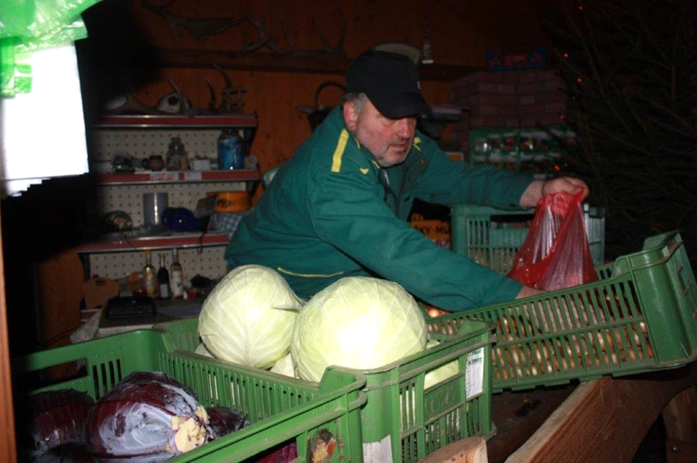
6. Sales from the Yard (Farm)
6.5.1 Plant products
6.5.2 Protective labeling of regional products in the EU
In terms of sales from the yard, the sale of plant products is easier than the sale of animal products.
Notes:
The module deals with the possible sale of crop products on farms. In addition to agricultural commodities and their products, additional sales of flowers are also mentioned. Focus on the production of non-traditional crops and products from them (sea buckthorn).

Slide 3
6.5.1. Conditions for the sale of plant products in selected EU countries
Czech Republic
It is not necessary to have a trade license to sell surpluses from the garden, unless it is a continuous activity.
From a tax point of view, sales from the yard may relate to non-food crop products, such as flowers. Sales from the yard can also be interesting for producers of special or non-traditional crops such as sea buckthorn.
Slovakia
The regulation of the sale of food of non-animal origin by the Food Act is relatively brief. Producers of small quantities of food who sell their products directly to the final consumer or deliver them to a retail establishment in Slovakia do not have to label the products with nutrition information (Section 9, paragraph 4 of the Food Act).
Blue food poppy is an integral part of the diet in the Czech Republic
Notes:
The condition of consistency is fulfilled if it is sold regularly throughout the year, which means that, for example, in the spring it starts with planting and sprouts are sold throughout the year as they grow. However, if, for example, surpluses of kohlrabi, cauliflower or cucumber are offered during the summer, this is not a continuous, independent and profit-making activity. Here, it is good to consult your activity at the trade license office, because regular sales every week, for example on the farmers' market, already fulfill a continuous activity in order to make a profit. It follows that, from tax point of view, sales from the yard may relate to non-food crop products, such as flowers. Sales from the yard can also be interesting for interested producers of special or non-traditional crops such as sea buckthorn. The Ministry of Agriculture of the Czech Republic, together with a draft law introducing the relevant empowering provision, prepared in 2013 a working version of a brief decree on hygienic requirements for foodstuffs of plant origin intended for direct sale and supply of small quantities, but this was not issued in this form.
Slovakia - a producer of small quantities of food is considered to be a producer who employs a maximum of 15 people who produce food in an employment or similar legal relationship, and their annual turnover does not exceed EUR 700,000. For the purposes of Section 9, Paragraph 4 of the Food Act, a producer who sells less than the specified commodities per year than stipulated in the Regulation of the Government of the Slovak Republic No. 360/2011 Coll. In the case of direct distribution of small quantities of primary products of plant origin, their safety, quality and nutritional value must be maintained (Section 7 (1) of Regulation No. 360/2011 Coll.). Producers are also obliged to keep records of the date, type and quantity of (1.) cultivated products of plant origin, (2.) products delivered to the final consumer directly on the farm or at the local market and (3.) products delivered to the local retail, including identification of their customer (§ 7 paragraph 3 of Regulation No. 360/2011 Coll.). Finally, the producer must ensure that the delivered vegetables and fruits are whole, healthy, clean, free of pests or damage from pulp-attacking pests, excessive surface moisture or foreign smell or taste (Section 7 (4) of Regulation No. 360/2011 Coll. ).

Slide 4
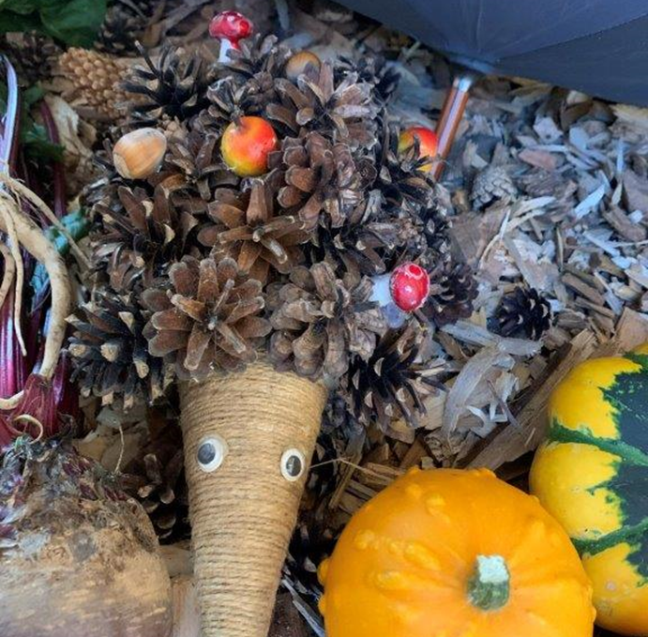
Hungary
Producers of non-animal products, honey, other apiculture products or live fish may specifically sell goods at all markets and markets, at sales events and at authorized temporary points of sale in Hungary and to retail outlets located in the same region or within 40 km from the manufacturer of the equipment (Section 4, paragraph 1 of Regulation No. 52/2010).
Poland
Poland has no special legislation for sales from the yard and everything is dealt with by the Food Safety and Nutrition Act. Polish food hygiene law is a direct follow-up to the Court's exception to food hygiene rules under the Food Hygiene Regulation and the Animal Food Hygiene Regulation.
Hungarian farmers harvesting reeds for handicrafts
Autumn decorative set with ornamental gourds

Slide 5
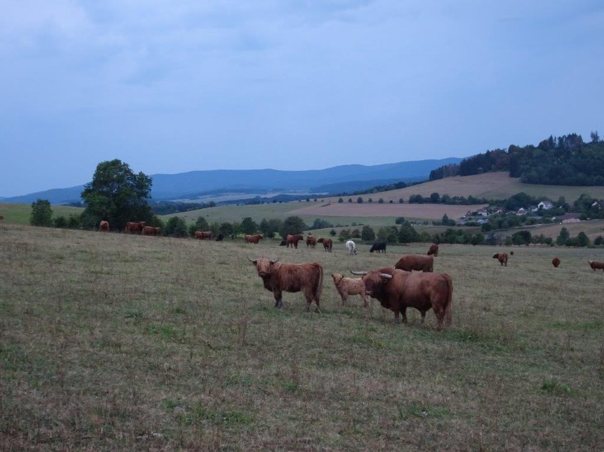
6. Sales from the Yard (Farm)
6.5.2. Protective labeling of regional products in the EU
In the context of world trade, regional products are protected by legal agreements and acts which make it possible to use a wide range of consumer-friendly trade marks.

Slide 6
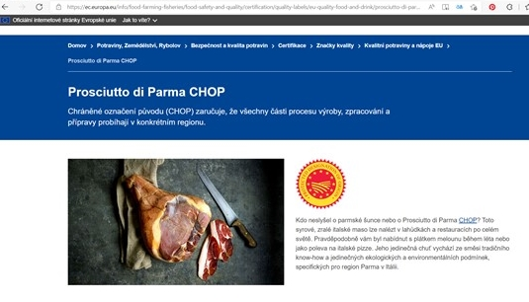
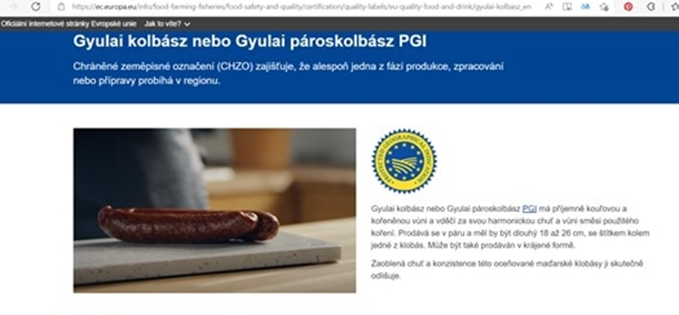
The Geneva Act is a multilateral treaty on the protection of geographical indications (designations of origin and geographical indications) administered by the World Intellectual Property Organization.
The Geneva Act updates and extends the existing system of international registration protecting names that identify the geographical origin of products under the 1958 Lisbon Agreement on the Protection of Designations of Origin and their International Registration.
The Lisbon Agreement and the Geneva Act of the Lisbon Agreement together form the Lisbon System and offer more comprehensive and effective international protection for quality product names based on origin.
Parma ham - an Italian product with a protected designation of origin
Protected geographical indication of the Hungarian sausage Gyulai kolbász
Notes:
The Geneva Act updates and extends the existing system of international registration protecting names that identify the geographical origin of products under the 1958 Lisbon Agreement on the Protection of Designations of Origin and their International Registration. The Lisbon Agreement only applies to designations of origin, products which have a particularly strong link to their place of origin. The Geneva Act extends this protection to geographical indications in order to take better account of existing national or regional protection systems in relation to quality characteristics based on origin. In addition, it introduces maximum flexibility as to how the standard of protection of the law can be implemented (ie through a specific designation of origin or geographical indication system or through a trademark system). The Geneva Act also allows certain intergovernmental organizations to join this labeling method, making the international protection system more inclusive. The Lisbon Agreement and the Geneva Act of the Lisbon Agreement together form the Lisbon system and offer more comprehensive and effective international protection for quality product names based on origin. On 26 November 2019, the European Union approved an instrument of accession to the Geneva Act. The EU's accession to the Geneva Act entered into force on 26 February 2020. As the Union was the fifth member to accede to the Geneva Act, the Geneva Act entered into force on the same day. Membership of the Geneva Act enables products protected by EU designations of origin (PDOs and PGIs) to obtain a high level of protection from other signatories to the Geneva Act. The following countries and unions have now acceded to the Geneva Act: Albania, Cambodia, the Democratic People's Republic of Korea, the European Union, France, Hungary, the Lao People's Democratic Republic, Oman, Samoa.

Slide 7
At European level, therefore, a regional product can be protected by several labels and logos. The aim of EU quality policy is to protect the names of specific products in order to promote their unique characteristics linked to their geographical origin and traditional know-how.
Product names may be given a "geographical indication" if they have a specific link to the place where they are produced. Recognition of geographical indications allows consumers to trust and differentiate between quality products, while helping manufacturers to better market their products.
Products that are being considered or granted GI recognition are listed in quality product registers. The registers also contain information on the geographical and production specifications of each product. The names of products which have either applied to become a geographical indication (GI) or a traditional specialty guaranteed (TSG) or which are now registered as a geographical indication or TSG are listed in the following registers:
eAmbrosia for food and agricultural products, wine, spirits and aromatised wine (legal registration);
Traditional terms protected in the European Union for wine;
Moderator (GLview) for all geographical indications protected at European Union level.
Geographical indications, which are recognized as intellectual property, are playing an increasingly important role in trade negotiations between the EU and other countries. Many products from outside the European Union are protected by bilateral agreements. All this can be found in the Moderator index (tmdn.org).
Other EU quality schemes emphasize traditional production processes or products from difficult natural areas, such as mountains or islands.

Slide 8
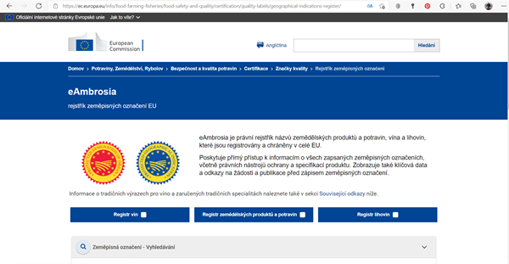
eAmbrosia – screen capture
Moderator – screen capture

Slide 9
Designation and logo Protected designation of origin (PDO) is the designation of an exceptional agricultural product or foodstuff from a given region or place, the quality or characteristics of which are determined by a specific geographical environment.
Protected products are food, agricultural commodities and wines. Each part of the production, processing and preparation process must take place in a specific region. For wines, this means that the grapes must come exclusively from the geographical area where the wine is produced. Designation for food and agricultural commodities is mandatory while for wine it is only optional.
Protected Designation of Origin logo
Notes:
As stated on the website of the Ministry of Agriculture of the Czech Republic, PDOs may bear those agricultural products or foodstuffs which come from a certain territory (region, place or in exceptional cases a country) for which the quality or characteristics of products or foodstuffs are exclusively or predominantly given the specific geographical environment with its characteristic natural and human factors, and if the production, processing and preparation of such goods take place in the defined territory.

Slide 10
A protected geographical indication (PGI) is an indication of an exceptional agricultural product or foodstuff from a given region or place.
In the case of a geographical indication, it is sufficient that only some of the stages of production (manufacture, processing or preparation) of the food or agricultural product take place in the defined area. The name of a region, a specific place or, in exceptional cases, a country, used to describe goods originating in that territory, if those goods have a certain quality, reputation or other characteristics attributable to that geographical origin and if the production or processing or preparation of such goods takes place in defined territory.
Protected geographical indication logo

Slide 11
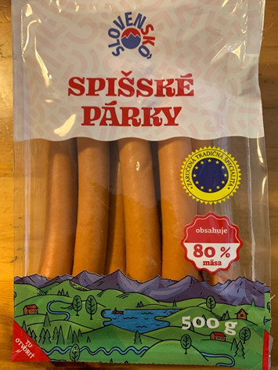
Food and agricultural products that have been produced by traditional methods for more than 30 years can be protected as "traditional specialties guaranteed" (TSG). According to that Regulation, the term 'traditional' means proven use on the Community market after a period of intergenerational transmission. This period should be equal to the time period generally attributed to one human generation, i.e., at least the mentioned 30 years. Unlike products with a protected geographical indication or a protected designation of origin, their production or preparation is not linked to a geographical area. They can therefore be produced anywhere when the conditions of production technology (so-called specialization) are met. When registering a Czech product, the same product can be manufactured by another manufacturer in another region, or even in another member state. The traditional specialty guaranteed emphasizes traditional aspects, such as the way the product is produced or its composition, without being linked to a specific geographical area. The product name, which is registered as a TSG, protects it from counterfeiting and misuse.
Therefore, in the interests of the proper functioning of the internal market in foodstuffs, Regulation (EU) No 1151/2012 of the European Parliament and of the Council on agricultural product and food quality schemes provides legal operators and food producers with legal instruments enabling them to increase their market value. protects them against unfair practices. Therefore, any producer registered in the official EU register has the possibility to use the registered name on their products together with the mention "traditional specialty guaranteed" and the appropriate logo.
Traditional specialty guaranteed logo
Popular Slovak Spiš sausages with the granted protected designation

Slide 12
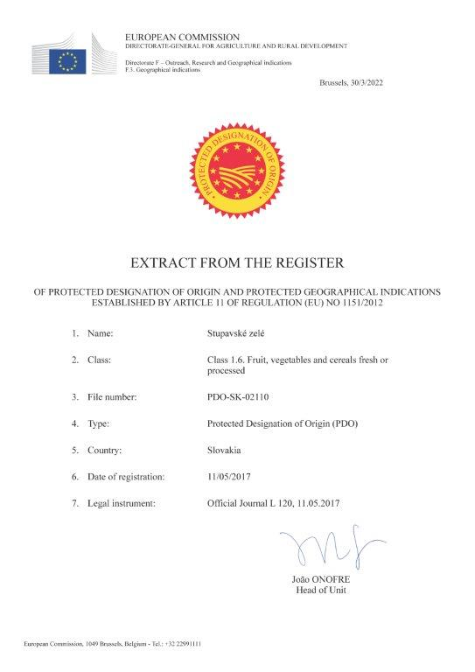
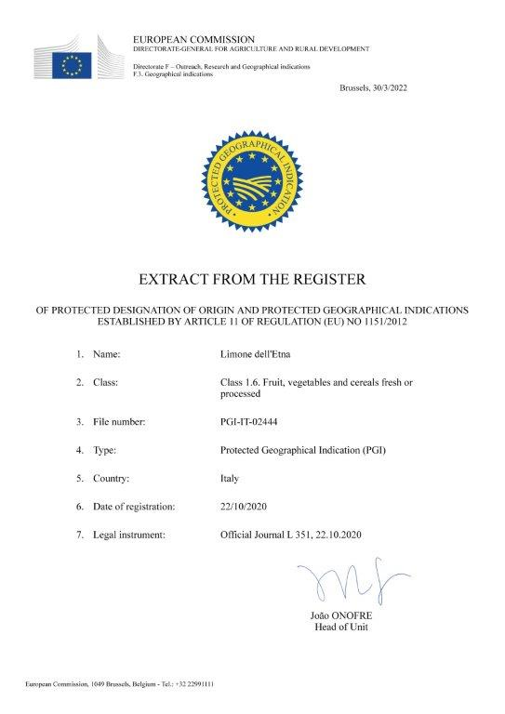
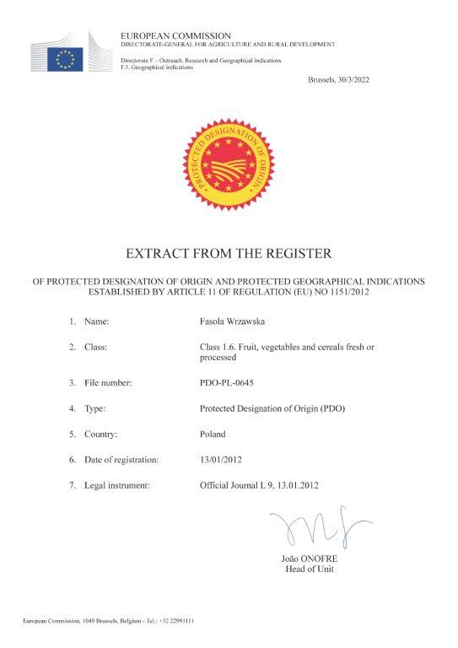
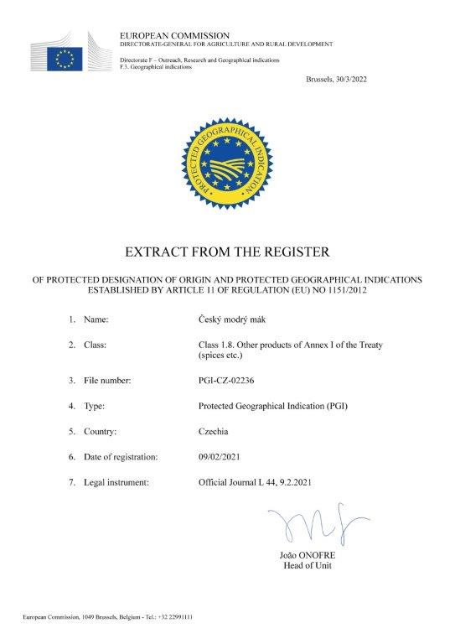
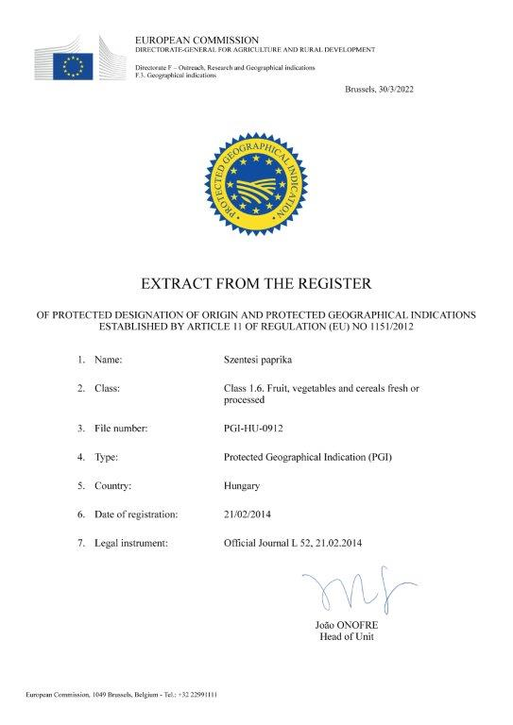

Slide 13
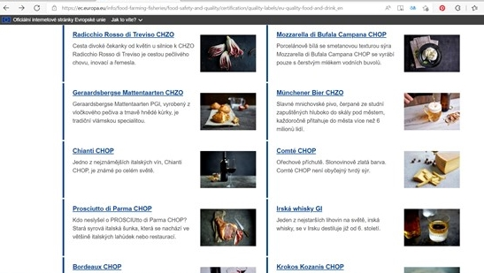
The European Union currently protects almost 3,400 names of agri-food products, including agricultural and food products, which also include fishery and aquaculture products; wines, spirits and aromatised wine products - under EU quality schemes.
The main objectives of the geographical indication and TSG systems are:
ensure the protection of specific product names and traditional production methods, including the protection of intellectual property rights;
ensure the integrity of the internal market;
achieve fair competition for farmers and producers;
provide farmers and producers with a fair return;
provide consumers with clear and reliable product information;
to create a competitive environment with a level playing field for producers in rural areas.

Slide 14
6.5.3. Protective signage in the Czech Republic
Each country also has its own national trademarks.
In the Czech Republic, in addition to a number of unofficial designations of food and agricultural commodities managed by various mostly non-profit organizations, designations administered by the Ministry of Agriculture of the Czech Republic are available.
KLASA logo
Regional food logo
Czech food logo
Notes:
The KLASA brand has been awarded by the Minister of Agriculture in the Czech Republic since 2003. The "KLASA" brand is lent to products for 3 years and is awarded to a manufacturer who meets the conditions for the "KLASA" brand and demonstrates exceptional quality characteristics that increase product value and its uniqueness in relation to common products on the market. The priority of the "KLASA" brand is to offer consumers quality food that has exceptional quality characteristics that increase its added value and guarantee its uniqueness in relation to common products available on the market. Markers referring to the origin of food with a logo that is identical to the Czech flag and bears the inscription "Czech food" or just the words "Czech food", food producers can voluntarily label their products, if they meet two basic conditions, it is a place of production in the Czech Republic and a specified proportion of Czech raw materials. The Regional Food brand is awarded by the Ministry of Agriculture to the highest quality agricultural and food products, which will win regional competitions. The product must be produced on the territory of the region in which the award was granted and from the raw materials of the area.

