Slide 2
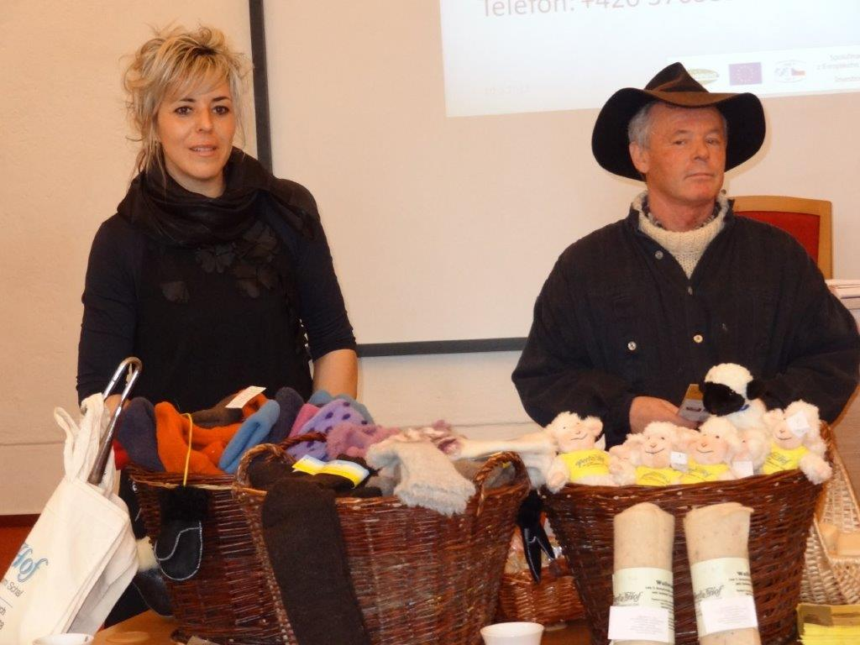
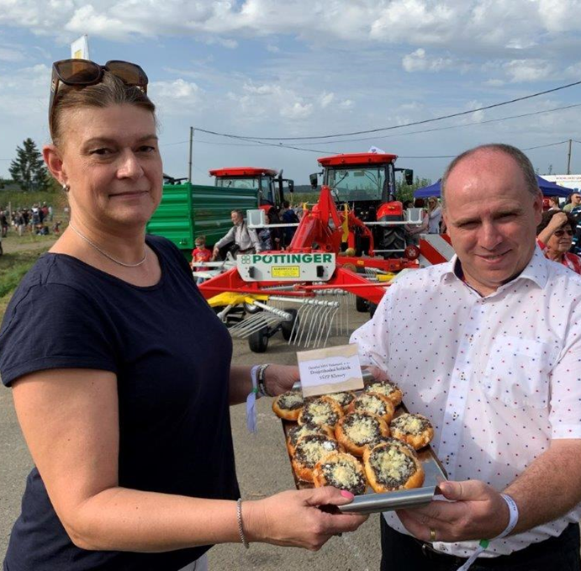
6. Sales from the Yard (Farm)
6.6. Other products, circular economy
Sales from the yard also include the offer of non-food production of a regional nature or the opportunity to try some stages of production. This makes it part of the offer of local eco-tourism activities.
Notes:
The module deals with the accompanying effects of sales from the yard, which may be the sale of own or regional non-food production (e.g. wood products, wicker, cosmetics). Synergies of sales from the yard and eco-tourism. Support and development of the circular economy as one of the possible measures to reduce the carbon footprint.

Slide 3
6.6.1. Other products
A variety of handicrafts, often typical of the region, or cosmetic gifts, soaps, candles, or food decorations — typically ornate gingerbread decorations — are often an integral part of yard sales, and their names often circumvent stricter food or cosmetics regulations.
Basketry retains a number of local specifics in the regions

Slide 4
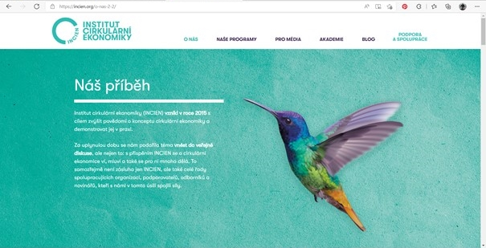
6.6.2. Circular economics
The Institute of Circular Economics states on its website that today only 9% of all materials and resources that have the potential to return to circulation are used. As a result, the current system is inefficient and hits its limits. The circular economy provides an answer to this problem by addressing the ecological, social and environmental weaknesses of the linear system.
www.incen.cz Institute of Circular Economics

Slide 5
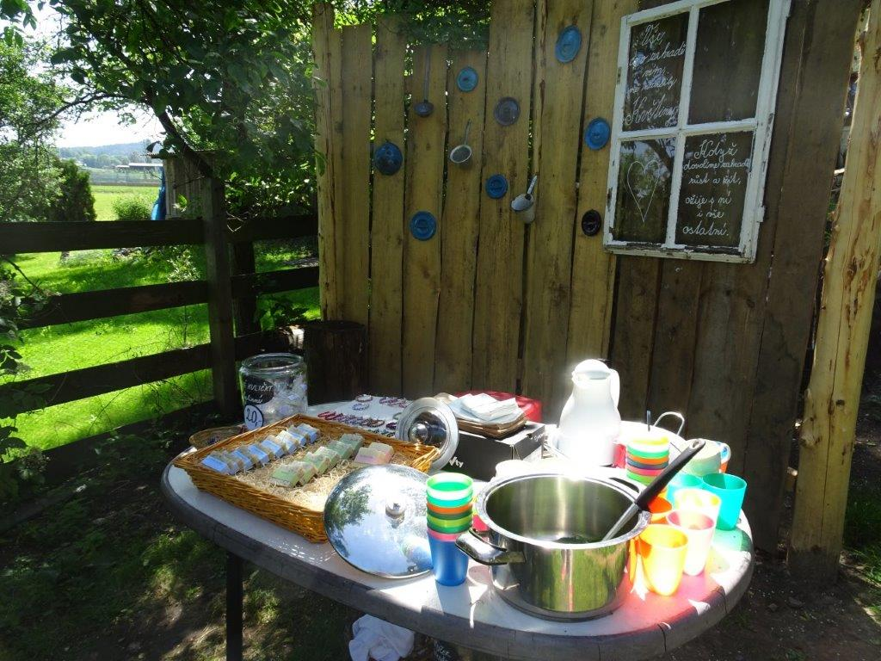
What characterizes the circular economy?
While the current economy and production works largely in a linear way - from raw materials, through the design, production and use of the product to the end of its life and waste production, the circular economy is trying to circle this flow of material and energy, source: server Nazeleno.cz (2020).
It is therefore an effort to introduce a system into the economy, where we consistently use recycled products and materials to produce other goods, and waste is not generated here.

Slide 6
In the circular economy, there is simply no waste,
and what we now consider waste is rather a
raw material for the next round of production
and the basis for product re-life.
Graphic representation of circular and linear economics Zdroj: Incien.org

Slide 7
Sales from the Yard (Farm)
6.6.3. Benefits of circular economics
The main benefits of the circular economy:
Less to zero waste production - waste is understood here as a raw material for further production.
Separation of economic growth from extraction of raw materials - in practice, the fulfillment of the goals of the circular economy is the separation of economic growth and extraction of raw materials. In Europe in particular, this could not only bring greater raw material independence, but also save around € 1.8 billion by 2030, according to the consulting firm McKinsey.
Elimination of the supply chain - the use of circular principles could also help to eliminate the often overcrowded supply chain, where products have to travel too long on the way from producer to consumer through many intermediaries. This not only makes products more expensive, but also burdens the environment.
Source: https://www.nazeleno.cz/
Sales from the yard mainly help to reduce the number of links in the supply chain.

Slide 8
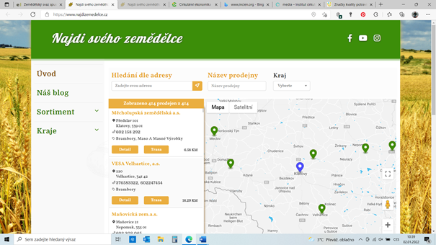
6.6.4 Examples of activities and projects in the Czech Republic
A number of projects have recently been initiated to support sales from the yard and the circular economy in general, both at the public and corporate levels or through non-profit sector activities.
Sales from the yard are supported by a number of marketing events, the publication of promotional leaflets and brochures and activities on the Internet with the support of social networks.
In a figurative sense, large farms also use direct sales due to its growing economic importance in Europe. In the Czech Republic, in 2021, the Agricultural Association launched the Find Your Farmer portal.
www.najdizemedelce.cz
Notes:
Find your farmer. According to ekolist.cz (2021), according to the union's representatives, it should not only be a map with local sellers, but companies should have the opportunity to promote themselves there. "We have to give people a story about that food. It motivates people to pay a higher price for local and farm food," said the union president. He added that currently marketing cannot be done without marketing, or at least not economically. In the future, if there is interest, the union is also considering launching an online store.

Slide 9
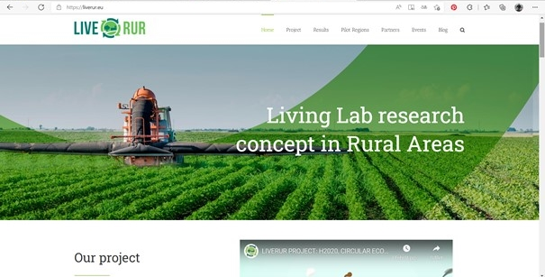
Projekty v České republice
Cirkularitou a ekonomikou na venkově se zabývají i národní a mezinárodní výzkumné projekty. Jedním z nich je projekt LIVERUR, který si klade za cíl podporovat podniky, projekty a iniciativy navrhováním inovativních obchodních modelů ve venkovských oblastech, zejména při přechodu k cirkulárnímu hospodářství a zapojením všech relevantních partnerů podle přístupu Living Lab. Základem strategického rozvoje laboratoří Rural Living Lab je vytvoření sítě partnerů, kde producenti a podnikatelé, zástupci veřejné správy, veřejnost a neziskový sektor a výzkum a akademická sféra uzavírají dohody, na jejichž základě se mohou podílet na dlouhodobější spolupráci.
www.liverur.eu project Horizon 2020

Slide 10
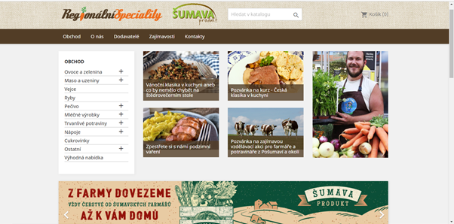
In the Czech Republic, a pilot e-shop with regional products was set up in south-western Bohemia to address this issue, which, in addition to the products of individual local farmers, also offers a range of other information about the area. The authors of the e-shop Úhlava, o.p.s., WirelessInfo and Šumavaprodukt, s.r.o. when establishing LivingLab Pošumaví, set the introduction of a digital platform to support retail sales of regional products as one of their important tasks.
In the first step, it was mainly the offer of production of local small companies to consumers in the region, even with the importation home.
E-shop with regional food

Slide 11
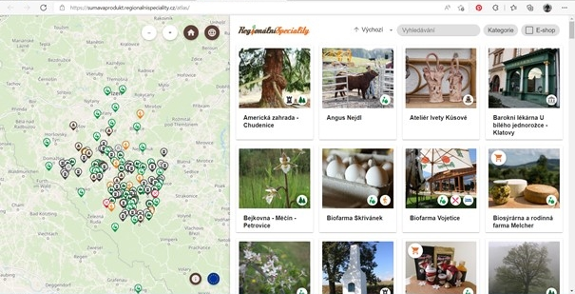
Gradually, other important goals were achieved, which logically appeared by connecting individual partners in the "living laboratory" - LivingLab. As part of the digital platform, information on individual suppliers, both agricultural enterprises and smaller food companies, is gradually being supplemented, expanded and updated. In the future, cooperation with local craftsmen and tradesmen is also planned. At the same time, information about tourist attractions in Šumava and Pošumaví is gradually being added to the atlas, which is part of the e-shop.
Atlas of tourist attractions included in the e-shop with regional food

